Slide 1
Flask-Based Doctor-Patient Health-Data Logger App
Team Members:
20J41A6724 - Juloori Abhay
20J41A6751 - Sai Bhargav Shivampeta
20J41A6752 - Sairy Muralidhar
21J45A6704 - Lc Yogeshwar Vijay Puri

Slide 2
Abstract
Introducing DPI WA, a game-changing Flask-based web app redefining doctor-patient interaction and appointment scheduling. With user-friendly dashboards, patients can easily schedule appointments and communicate with healthcare providers, taking control of their well-being. This innovative system streamlines healthcare data management, empowering individuals and fostering trust. DPI WA transcends geographical barriers, paving the way for a connected, efficient, and patient-centric healthcare system.

Slide 3
Hardware Requirement
Software Requirement Specification
Software Requirement
Processor : i3 7th Gen or better
Windows 11
Python 3.9 or newer
Flask
Web Browser
Necessary Python Modules
Ram: 8GB or better
Storage : 120GB OR More

Slide 4
Technologies Used
JavaScript
Flask
Python
Html
Css

Slide 5
01
02
03
04
05
Why You Should You Use Our Website ?
Centralized Platform
Enhanced
Interaction
Streamlined Administrative Tasks
Management of Health Records
Improved Efficiency And Reduced Errors

Slide 6
Patient Side Interface
Create Patient Profiles
Book Appointments
Interact With Doctors
Check Availability of Slots
Share About Illness
Download Prescriptions
Download Reports and many things…

Slide 7
Doctor Side Interface
Create Doctor Profiles
Check Appointments
Interact With Patients
Manage Availability of Slots
Review Illness
Prescribe medications and Suggestions
Share Reports of Patients and many things…

Slide 8
Future Work and Enhancements
The project offers promising features and functionalities for the healthcare sector. Future enhancements and development opportunities include:
Implementation of telemedicine capabilities to enable virtual consultations.
Integration with external health record systems for data synchronization.
Enhanced data visualization for medical professionals.
Expansion of the app's scalability to accommodate a larger user base.

Slide 9
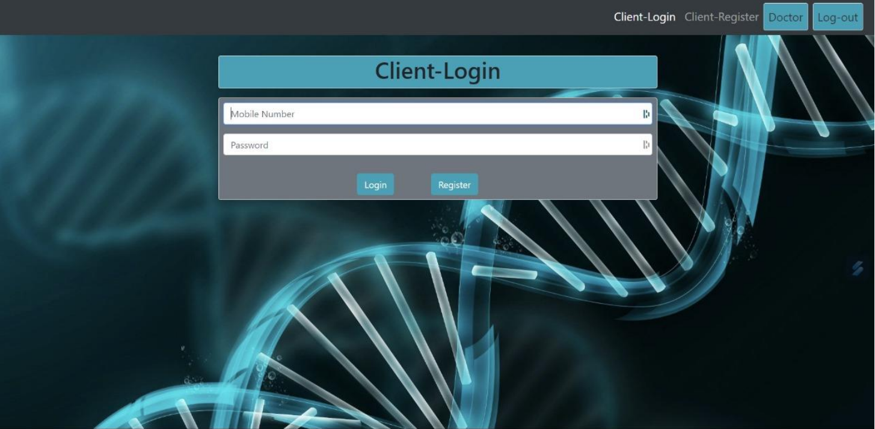
Run Time ScreenShots

Slide 10
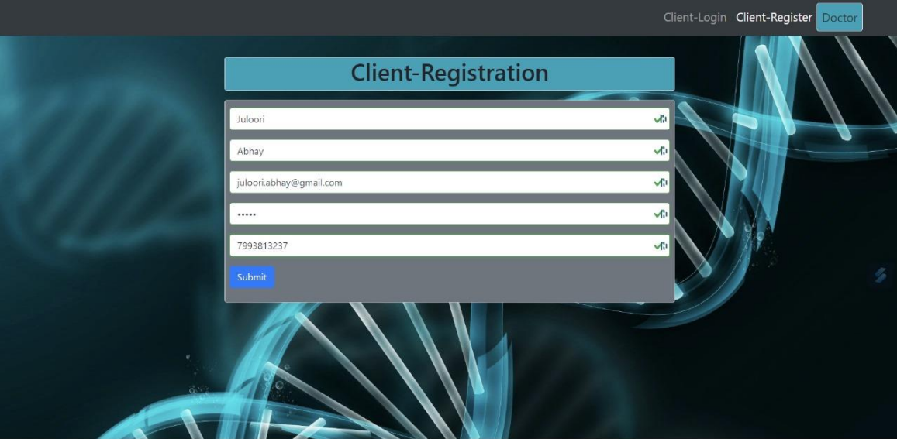
Patient Side Login

Slide 11
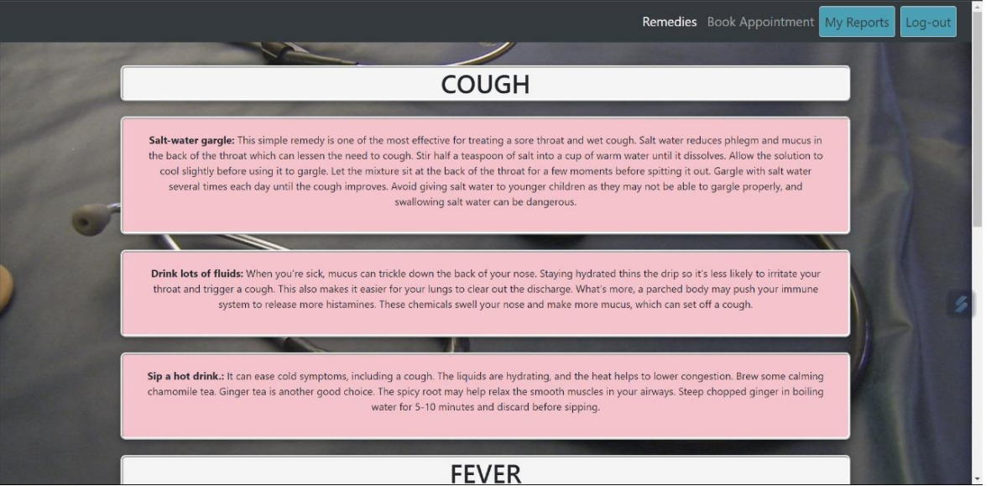
Health Tips

Slide 12
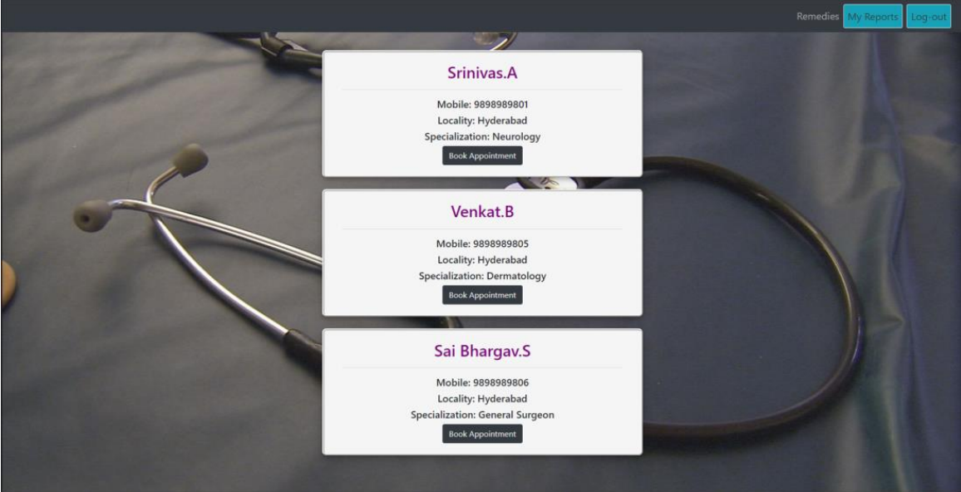
Specialist Doctors and Appointment

Slide 13
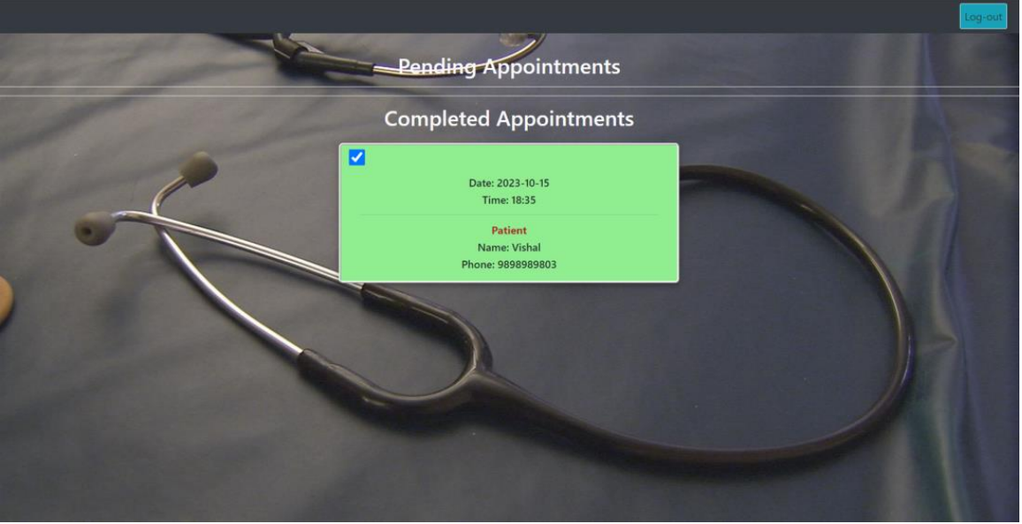

Slide 14

A Friendly UI Always Reinforces the Experience Of Patients..

Slide 15
Thanks

